Slide 1

Python 1441032 (11-12)
Lesson 1 by A.Abraham Ariel University, Spring 2020

Slide 2
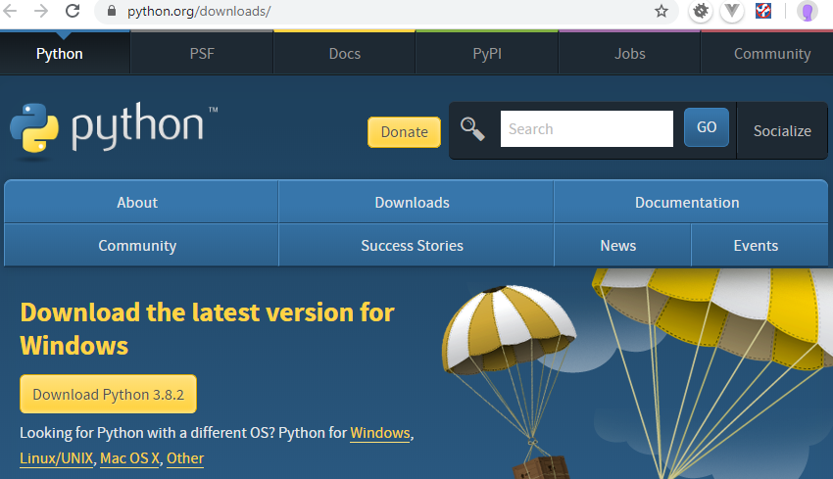
Installation | התקנה
PYTHON: https://www.python.org/downloads/

Slide 3
תיעוד |Documentation
Python official documentation: https://docs.python.org/3.8/tutorial/index.html
Google python course : https://developers.google.com/edu/python/
http://interactivepython.org/courselib/static/thinkcspy/index.html
http://cscircles.cemc.uwaterloo.ca/
http://www.greenteapress.com/thinkpython/thinkpython.pdf
http://en.wikibooks.org/wiki/Think_Python
http://files.swaroopch.com/python/byteofpython_120.pdf

Slide 4
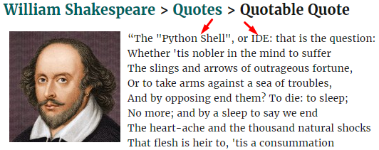
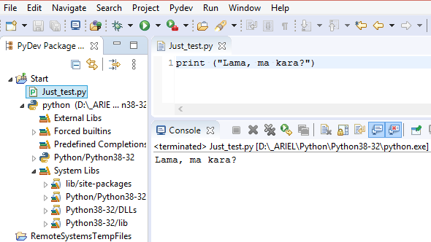
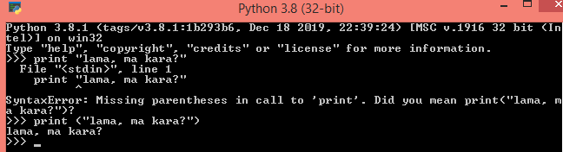
IDE | סביבות פיתוח

Slide 5
IDE (2): Eclipse + PyDev
PROS: free, powerful
CONS: not so powerful and quite slow, there are others, much better… but a bit expensive
Installation Requirements:
Java 8 (required for Eclipse to work) /160MB https://www.oracle.com/java/technologies/javase-jdk13-downloads.html Or https://www.oracle.com/technetwork/java/javase/downloads/jdk13-downloads-5672538.html
Eclipse IDE (~300Mb)
http://www.eclipse.org/downloads/packages/release/2019-12/r/eclipse-ide-web-and-javascript-developers-includes-incubating-components
Required installation: "Eclipse IDE for JavaScript and Web Developers (includes incubating components)"
PyDev - python plugin for the Eclipse (http://www.pydev.org/ , http://www.pydev.org/manual_101_install.html)

Slide 6
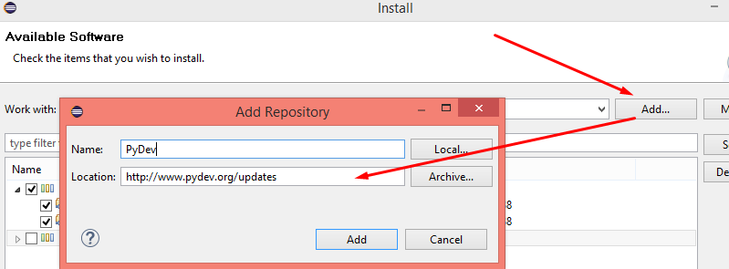
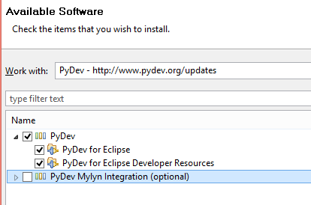
IDE (3): Eclipse + PyDev
In Eclipse: Help > Install New Software... menu. In the pop up window press “Add” and enter the following address (http://www.pydev.org/updates)
Select PyDev extensions:

Slide 7
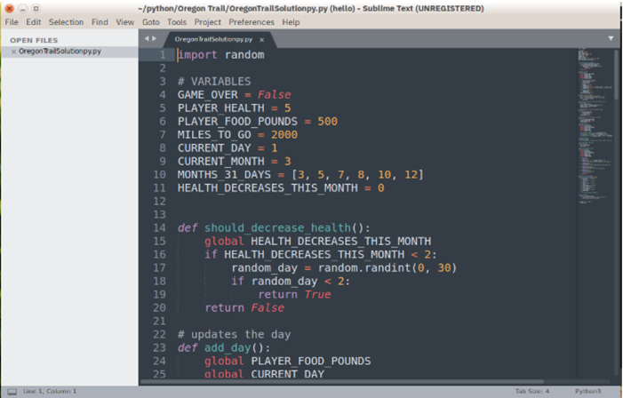
Other IDEs: Sublime Text
Sublime Text http://www.sublimetext.com
אינו חינמי, אבל יכול להשתמש בתקופת הניסיון ככל שתרצו. התקנת תוספים יכולה להפוך למסע הרפתקאות . בנוסף, העורך אינו תומך באגים ובהרצת קוד.

Slide 8
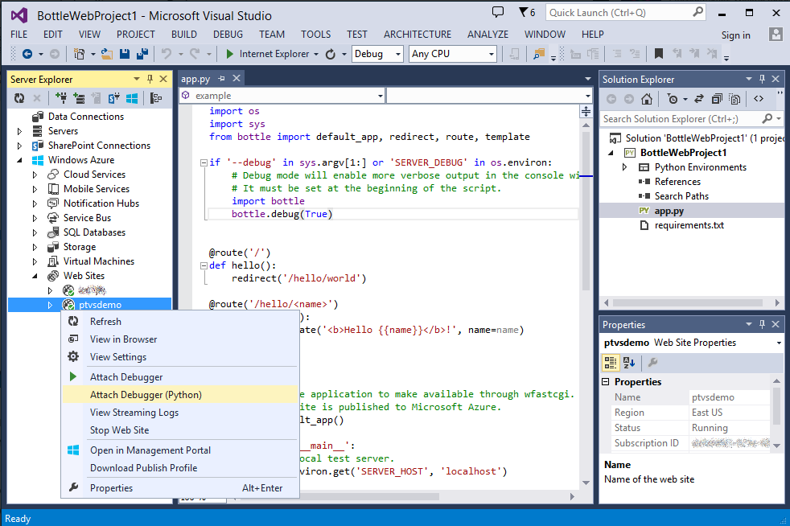
Other IDEs: Visual Studio
MS Visual Studio: https://www.visualstudio.com/vs/
Python-extension: Python Tools for Visual Studio,(PTVS)
WIN only!!!

Slide 9
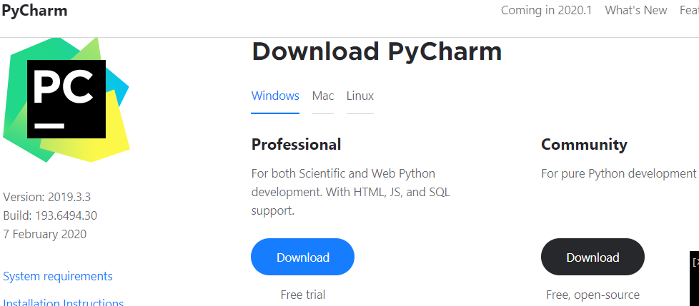
Other IDEs: PyCharm – built FOR Python!
PyCharm: https://www.jetbrains.com/pycharm/

Slide 10
יסודות השפה: מילות מפתח, משתנים, מפעילים, מבני נתונים בסיסיים, פונקציות. keywords, variables, operators, basic data structures, functions

Slide 11
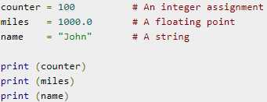
Variables - משתנים
Variables are nothing but reserved memory locations to store values.
numerical types −
int (signed integers)
float (floating point real values)
complex (complex numbers)
All integers in Python3 are represented as long integers.
Strings, lists, tuples, dictionaries, sets, …

Slide 12
Operators - מפעילים
types of operators −
Arithmetic Operators +, -, *, /, %, ** (exponent), // (Floor Div): 9//2 = 4 and 9.0//2.0 = 4.0, -11//3 = -4, -11.0//3 = -4.0)
Comparison (Relational) Operators
==, !=, >, <, >=, <=
Assignment Operators =, +=, -=, (see arithmetic operators)
Logical Operators : and, or, not
Bitwise Operators: &, |, ^, ~
Membership Operators: in, not in
Identity Operators: is, is not

Slide 13
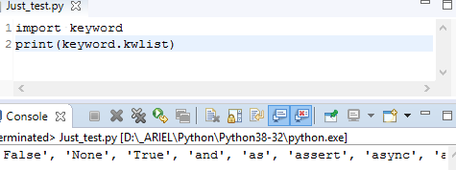
יסודות השפה: מילות מפתח, משתנים, מפעילים, מבני נתונים בסיסיים, פונקציות.
>>> import keyword >>> print(keyword.kwlist)
['False', 'None', 'True', 'and', 'as', 'assert', 'break', 'class', 'continue', 'def', 'del', 'elif', 'else', 'except', 'finally', 'for', 'from’, 'global', 'if', 'import', 'in', 'is', 'lambda', 'nonlocal', 'not', 'or', 'pass', 'raise', 'return', 'try', 'while', 'with', 'yield']
False, None, True, and, not, or
as, assert,
def, lambda, return,
if, else, elif,
for, while, in, break, continue,
global, nonlocal,
try, except, raise, finally,
class, pass,
del, from, import, is, with, yield,
async, await.

Slide 14
יסודות השפה: מילות מפתח Python Keywords: False, True, None, and, not, or
True and False are truth values in Python. They are the results of comparison operations or logical (Boolean) operations in Python. For example:
>>> 1 == 1 True >>> 5 > 3 True >>> True or False True >>> 10 <= 1 False >>> 3 > 7 False >>> True and False False
True and False in python is same as 1 and 0
>>> True == 1 True >>> False == 0 True >>> True + True 2

Slide 15
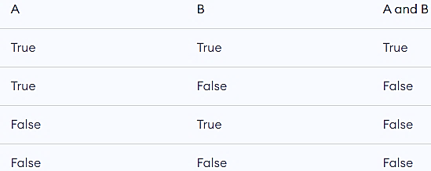

יסודות השפה: מילות מפתח Python Keywords: False, True, None, and, not, or
and, or, not are the logical operators in Python.
and will result into True only if both the operands are True.
or will result into True if any of the operands is True.
not operator is used to invert the truth value.
>>> True and False False >>> True or False True >>> not False True

Slide 16
יסודות השפה: מילות מפתח Python Keywords: False, True, None, and, not, or
None represents the absence of a value or a null value.
None does not imply False, 0 or any empty list, dictionary, string etc.
It is an object of its own datatype, the NoneType. We cannot create multiple None objects but can assign it to variables. These variables will be equal to one another.
Functions that do not return anything will return a None object.
None is also returned by functions in which the program flow does not encounter a return statement
Function that does not return a value, although it does some operations inside will return None
>>> None == 0 False >>> None == [] False >>> None == False False
>>> x = None >>> y = None >>> x == y True
def a_void_function():
a = 1
b = 2
c = a + b
x = a_void_function()
print(x)
Output
None
def improper_return_function(a):
if (a % 2) == 0:
return True
x = improper_return_function(3)
print(x)
Output
None

Slide 17
יסודות השפה: מילות מפתח Python Keywords: as, assert
as - to create an alias while importing a module.
assert - for debugging purposes. Prints the internal state or check if our assumptions are true.
followed by a condition. If the condition is false, AssertionError is raised. >>> a = 4 >>> assert a < 5 >>> assert a > 5, "The value of a is too small" Traceback (most recent call last): File "<string>", line 301, in runcode File "<interactive input>", line 1, in <module> AssertionError: The value of a is too small
>>> import math as myAss >>>myAss.cos(myAss.pi) -1.0

Slide 18
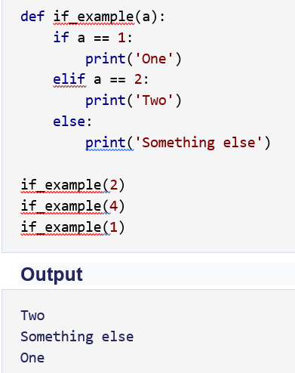
יסודות השפה: מילות מפתח Python Keywords: if, elif, else
if, else, elif are used for conditional branching or decision making

Slide 19
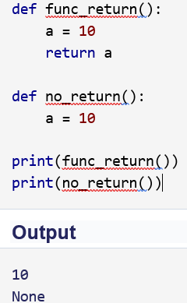


יסודות השפה: מילות מפתח Python Keywords: def, lambda, return
def is used to define a user-defined function. Function is a block of related statements, which together does some specific task. It helps us organize code into manageable chunks and also to do some repetitive task.
return statement is used inside a function to exit it and return a value.
lambda is used to create an anonymous function (function with no name). It is an inline function that does not contain a return statement. It consists of an expression that is evaluated and returned.

Slide 20
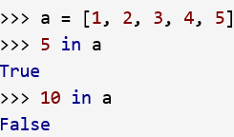

יסודות השפה: מילות מפתח Python Keyword: in
in is used to test if a sequence (list, tuple, string etc.) contains a value. It returns True if the value is present, else it returns False.

Slide 21

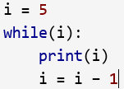
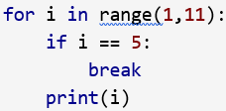
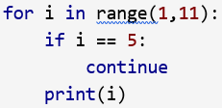
יסודות השפה: מילות מפתח Python Keywords: for, while, in, break, continue
for & in are used for looping. Generally we use for when we know the number of times we want to loop.
while loop continue to execute until the condition for the while loop evaluates to False or a break statement is encountered.
break will end the smallest loop it is in and control flows to the statement immediately below the loop.
continue causes to end the current iteration of the loop, but not the whole loop.

Slide 22
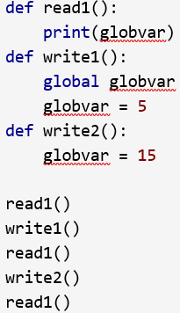
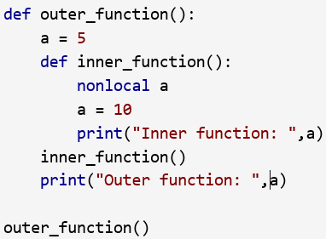
יסודות השפה: מילות מפתח Python Keywords: global, nonlocal
global is used to declare that a variable inside the function is global (outside the function). If we need to modify the value of a global variable inside a function, then we must declare it with global. Otherwise a local variable with that name is created.
nonlocal is used to declare that a variable inside a nested function (function inside a function) is not local to it, meaning it lies in the outer inclosing function.

Slide 23
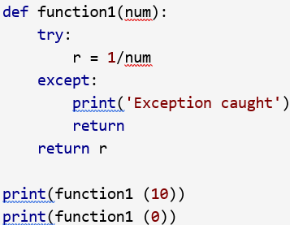
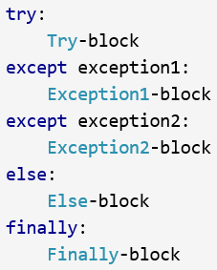

יסודות השפה: מילות מפתח Python Keywords: try, except, raise, finally,
except, raise, try are used with exceptions in Python. Exceptions are basically errors that suggests something went wrong while executing our program. IOError, ValueError, ZeroDivisionError, ImportError, NameError, TypeError etc. are few examples of exception in Python. try...except blocks are used to catch exceptions in Python.
We can raise an exception explicitly with the raise keyword.
finally is used with try…except block to close up resources or file streams. Using finally ensures that the block of code inside it gets executed even if there is an unhandled exception.

Slide 24


יסודות השפה: מילות מפתח Python Keywords: from, import
import keyword is used to import modules into the current namespace. from…import is used to import specific attributes or functions into the current namespace.
Now we can use the cos() function inside it as math.cos().
if we wanted to import just the cos() function, this can done using from
now we can use the function simply as cos(), no need to write math.cos().

Slide 25
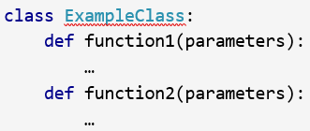


יסודות השפה: מילות מפתח Python Keywords: class, pass
class is used to define a new user-defined class in Python.
Class is a collection of related attributes and methods that try to represent a real-world situation. This idea of putting data and functions together in a class is central to the concept of object-oriented programming (OOP).
Classes can be defined anywhere in a program. But it is a good practice to define a single class in a module.
Pass is a null statement in Python. Nothing happens when it is executed. It is used as a placeholder.

Slide 26
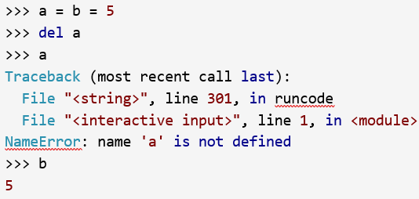
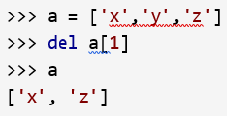
יסודות השפה: מילות מפתח Python Keyword: del
Everything is object in Python. del is used to delete the reference to an object.

Slide 27
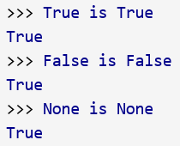
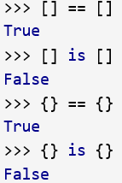
יסודות השפה: מילות מפתח Python Keyword: is
is - is used in Python for testing object identity. While the == operator is used to test if two variables are equal or not, is is used to test if the two variables refer to the same object. It returns True if the objects are identical and False if not.

Slide 28
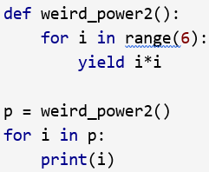
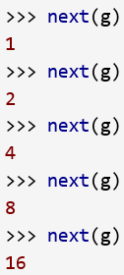

יסודות השפה: מילות מפתח Python Keyword: yield
yield is used inside a function like a return statement. But yield returns a generator. Generator is an iterator that generates one item at a time. A large list of value will take up a lot of memory. Generators are useful in this situation as it generates only one value at a time instead of storing all the values in memory.
This type of generator is returned by the yield statement from a function.

Slide 29

יסודות השפה: מילות מפתח Python Keyword: with
with statement is used to wrap the execution of a block of code within methods defined by the context manager. Context manager is a class that implements __enter__ and __exit__ methods. Use of with statement ensures that the __exit__ method is called at the end of the nested block. This concept is similar to the use of try…finally block.

Slide 30
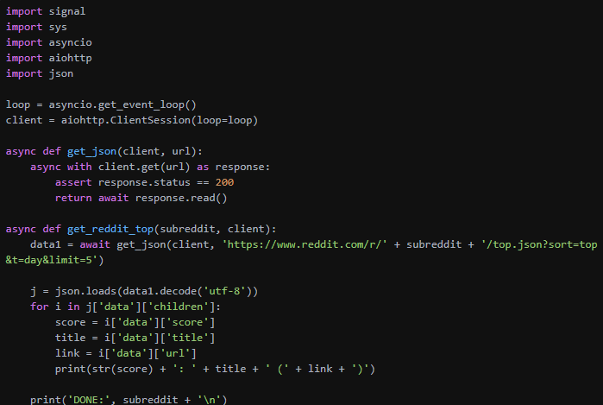
יסודות השפה: מילות מפתח Python Keywords: async, await
https://docs.python.org/3/library/asyncio-task.html
async def ping_local():
return await ping_server('192.168.1.1’)
async def ping_server(ip): # ping code here...

Slide 31
Assignments
EX1
If we list all the natural numbers below 10 that are multiples of 3 or 5, we get 3, 5, 6 and 9. The sum of these multiples is 23.
Find the sum of all the multiples of 3 or 5 below 1000.
EX2:
Ask the user for a number. Depending on whether the number is even or odd, print out an appropriate message to the user. Hint: how does an even / odd number react differently when divided by 2?
Extras:
If the number is a multiple of 4, print out a different message.
Ask the user for two numbers: * a number to check /variable/ * a number to divide by /dividor/. If dividor divides evenly into variable, tell that to the user. If not, print a different appropriate message.

